Slide 1
DeepRoadMapper: Extracting Road Topology from Aerial Images
An approach that directly estimates road topology from aerial images.
an initial segmentation of the aerial images
an algorithm that reasons about missing connections in the extracted road topology as a shortest path problem that can be solved efficiently.
Notes:
提出了一种直接从航空图像估计道路拓扑的方法。
对航拍图像进行初步分割；该算法将提取的推理道路拓扑中不连接部分作为可以有效解决的最短路径问题

Slide 2
1 Introduction
Creating maps of our roads is a fundamental step in many application domains.
Autonomous driving
Building smart cities
Most companies use sensors to capture LIDAR point clouds. A semi-manual process is then utilized to create the road network.
can achieve very accurate results, but coverage is very limited
HD maps are available for only a small region
An alternative approach is to use aerial and satellite images
they have much larger coverage, but the resolution is lower
Occlusion (e.g., trees) and large shadows cast by tall buildings are difficult to handle
Notes:
创建道路地图是许多应用领域的基本步骤。自动驾驶：路线规划、定位、缓解感知；建设智慧城市：了解道路网络、交通模式：通勤时间更快、更好的公共交通系统、更健康的环境
大多数公司使用传感器捕获LIDAR点云。 然后利用半手动过程来创建道路网络。 可以获得非常准确的结果，但覆盖范围非常有限; 高清地图仅适用于一个小区域
另一种方法是使用航空和卫星图像: 他们有更大的覆盖范围, 分辨率要低得多; 遮挡物（例如树木）和高层建筑物的大阴影很难处理

Slide 3
1 Introduction
Most existing approaches cast the problem as semantic segmentation, but these approaches ignore topology.
Recently, another approach leveraged existing maps to enhance them with road-width as well as information about the number of lanes, their location, parking spaces and sidewalks.
these approaches cannot reason about roads that are not present in the initial coarse map.
Notes:
大多数现有方法将问题视为语义分段，但这些方法忽略了拓扑。
最近，另一种方法利用现有的地图来增强它们的道路宽度以及有关车道数量，位置，停车位和人行道的信息。
这些方法无法推断初始粗略地图中不存在的道路。

Slide 4
2 Related work
Several methods extract low level features and define heuristic rules
e. g. Geometric-stochastic road models
the width, length and curvature of the road
the pixel intensities
their context including knowledge about their radiometry, geometry and topology
homogeneous areas
Convolutional neural ：
applied at the patch level in multiple to capture more context and structure
existing maps are used for data augmentation
The extracted road network and a road database are merged
Notes:
有几种方法可以提取低维特征并定义一些常识规则：几何随机道路模型：
道路的宽度，长度和曲率、像素强度、他们的背景包括他们的辐射测量，几何学的知识和拓扑、同质区域
卷积神经：块级别应用多个以捕获更多上下文和结构; 现有地图用于数据增强; 提取的道路网络和道路数据库被合并

Slide 5
2 Related work
heuristic rules’ drawback：
obtaining the optimal set of rules and parameters is very difficult
the high variety of roads.
the used features (e.g. image edge) occur predominantly at roads
Convolutional neural networks’ drawback:
connectivity of roads is not guaranteed
Notes:
缺点
获得最佳规则和参数集非常困难；道路多变；使用的特征（例如图像边缘）主要发生在道路上
神经网络不能保证连通性

Slide 6
2 Related work
Connectivity：
Chai et al. [3] define a junction point process:
The process uses various priors:
homogeneity of the pixel values
connectivity of the graph
edge orientation and line width
In [19], a Point Process is defined to describe the interaction of line segments:
minimizing an energy function using simulated annealing
Notes:
连通性：Chai等人。 [3]定义一个连接点过程：
该过程使用各种先验：
像素值的均匀性、图的连通性、边缘方向和线宽
在[19]中，定义了一个点过程来描述线段的相互作用：使用模拟退火最小化能量函数

Slide 7
2 Related work
Connectivity：
In [22], the road extraction is limited to tree structures:
guarantees the connectivity and the optimization
posing a significant limitation-roads are not tree-structured
This approach was further extended to loopy graphs in [21]
approximately solved by a branch and cut algorithm
Wegner et al. [24, 25] segment the image into superpixels
high road likelihood are connected by a shortest path algorithm
the goal of creating an overcomplete representation of the road network.
Notes:
连通性：
在[22]中，道路提取仅限于树结构：保证连接和优化、构成重大限制 - 道路不是树状结构
这种方法进一步扩展到[21]中的循环图：通过分支和切割算法近似求解
Wegner等。 [24,25]将图像分割成超像素：高道路可能性通过最短路径算法连接，目的是创建道路网络的过度完整表示。

Slide 8
2 Related work
Connectivity：
Mattyus et al. [13] improve existing freely-available road maps by extracting road width information and by correcting the position of the centerline.
In [14], aerial and ground images are utilized jointly in order to extract fine-grained road information like the number of lanes, presence of sidewalks and parking lanes.
GPS trajectories, the OpenStreetMap project, Recorded GPS tracks …
Notes:
连接：
Mattyus等。 [13]通过提取道路宽度信息并通过校正中心线的位置来改进现有的可自由使用的道路地图。
在[14]中，联合使用空中和地面图像，以提取细粒度的道路信息，如车道数量，人行道和停车道的存在。
GPS轨迹，OpenStreetMap项目，录制的GPS轨迹......

Slide 9
3 Road Topology from Aerial Images
A graph representation of the road network:
The nodes represent end points
the edges define the road segment center lines
Towards this goal:
segment the images into the categories
thinning extracts the road centerlines
connection hypotheses covering the disconnects
Notes:
道路网络的图形表示：
节点代表端点
边缘定义了路段中心线
为实现这一目标：
将图像分成类别
细化提取道路中心线
覆盖断开连接的连接假设

Slide 10
3.1 Semantic segmentation of Aerial Images
a variant of ResNet [8], Similar to FCN [18]:
an encoder that compresses the image into a small feature map
55 convolutional layers with 3 * 3 kernels
divides the whole encoding network in 4 parts, 16, 32, 64 and 128 kernels in each of these parts
a fully convolutional decoder generates the segmentation output
3 fully convolutional layers with number of kernels 64, 32 and 16 respectively
each of these layers takes feature maps directly from the encoder as input as well as two additional skip connections from the stride convolution.
a convolutional layer to output the class labels
Notes:
ResNet [8]的变体，类似于FCN [18]：将图像压缩为小特征映射的编码器; 55个具有3 * 3内核的卷积层; 将整个编码网络划分为4个部分，16,32,64和128个内核
完全卷积解码器产生分段输出概率: 3个完全卷积层，分别具有多个内核64,32和16’; 这些层中的每一层都直接从编码器获取特征图作为输入，以及来自步幅卷积的两个额外跳过连接。
卷积层输出类标签

Slide 11


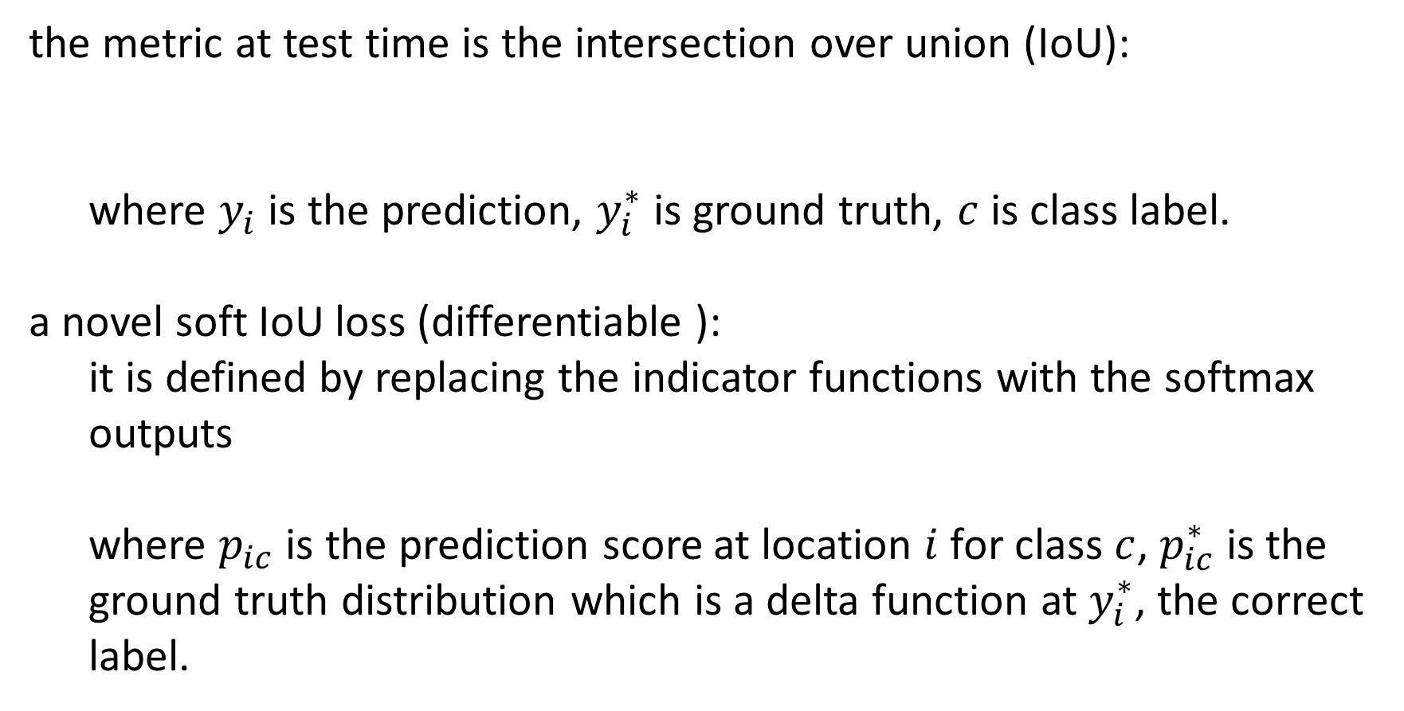
3.1 Semantic segmentation of Aerial Images
the metric at test time is the intersection over union (IoU):
where $y_{i}$ is the prediction, $y_{i}^{∗}$ is ground truth, $c$ is class label.
a novel soft IoU loss (differentiable ):
it is defined by replacing the indicator functions with the softmax outputs
where $p_{ic}$ is the prediction score at location $i$ for class $c$, $p_{ic}^{∗}$ is the ground truth distribution which is a delta function at $y_{i}^{∗}$, the correct label.
Notes:
测试时的指标是联合交集（IoU）：
其中𝑦_𝑖是预测，𝑦_𝑖^ *是真实图，𝑐是类标签。
一种新颖的软IoU损失（可区分）：
它通过用softmax输出来替换指示函数定义
其中𝑝_𝑖𝑐是类𝑐的位置prediction的预测分数，𝑝_𝑖𝑐^ *是地面实况分布，它是正确标签𝑦_𝑖^ *的delta函数。

Slide 12
3.2 Road graph generation
produce a graph representing the topology of the network:
we first generate a binary mask from the softmax output
Then apply thinning [28] to extract the road centerlines
simplify the graph
remove curves with length smaller than 5m
convert each loop of size smaller than 100 m into a tree
Notes:
生成一个表示网络拓扑的图表：
我们首先从softmax输出生成二进制掩码
然后应用细化[28]来提取道路中心线
这导致图形，以简化图形
删除长度小于5米的曲线
将每个小于100米的循环转换为树

Slide 13
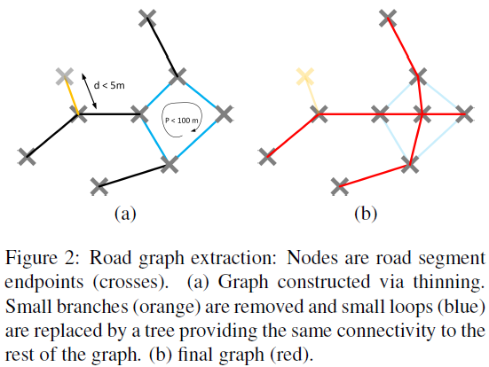
3.2 Road graph generation
produce a graph representing the topology of the network:
we first generate a binary mask from the softmax output
Then apply thinning [28] to extract the road centerlines
simplify the graph
remove curves with length smaller than 5m
convert each loop of size smaller than 100 m into a tree
Notes:
生成一个表示网络拓扑的图表：
我们首先从softmax输出生成二进制掩码
然后应用细化[28]来提取道路中心线
这导致图形，以简化图形
删除长度小于5米的曲线
将每个小于100米的循环转换为树

Slide 14
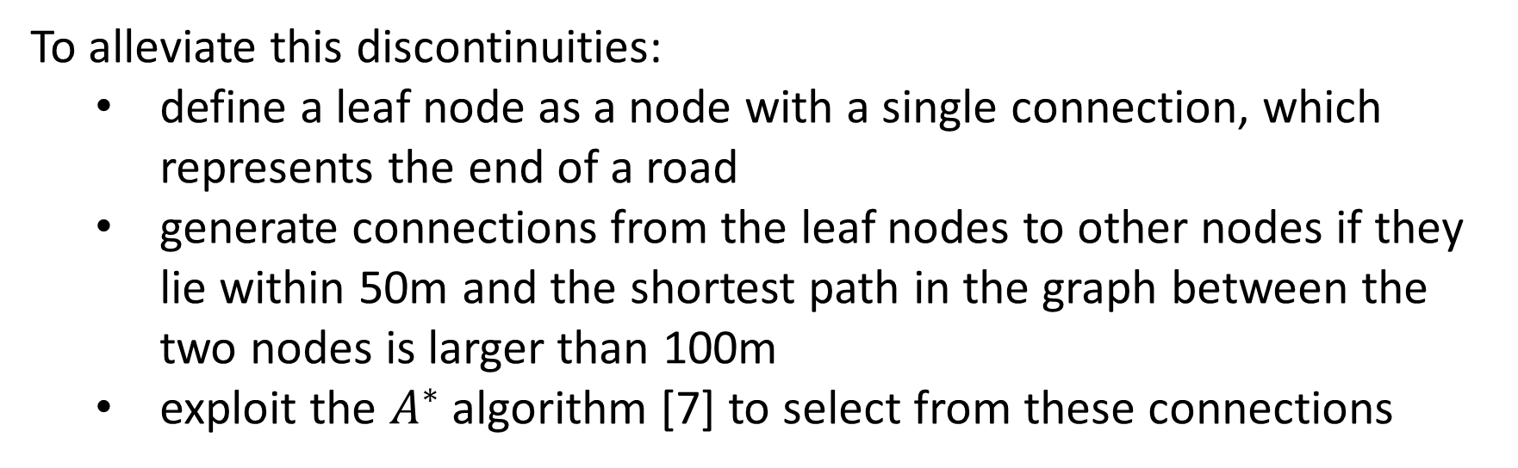
3.3 Generating connection hypotheses by $A^{∗}$ search
To alleviate this discontinuities:
define a leaf node as a node with a single connection, which represents the end of a road
generate connections from the leaf nodes to other nodes if they lie within 50m and the shortest path in the graph between the two nodes is larger than 100m
exploit the $A^{∗}$ algorithm [7] to select from these connections
Notes:
为了缓解这种不连续性：
将叶节点定义为具有单个连接的节点，该连接表示道路的末端
如果叶节点位于50米以内，则生成从叶节点到其他节点的连接，并且两个节点之间的图中最短路径大于100米
利用A算法[7]从这些连接中进行选择
非道路的概率分数作为我们的节点代价
距离是我们的边缘代价
欧氏距离作为我们的启发式

Slide 15
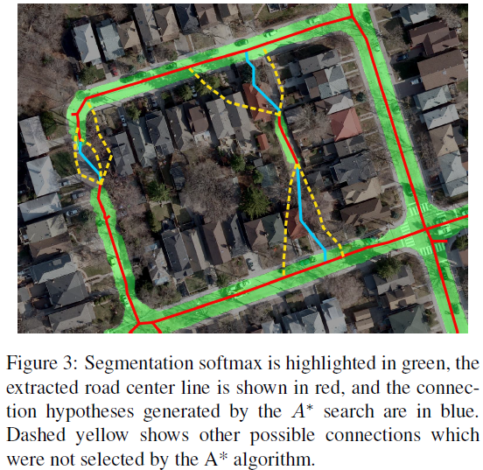
3.3 Generating connection hypotheses by $A^{∗}$ search
To alleviate this discontinuities:
define a leaf node as a node with a single connection, which represents the end of a road
generate connections from the leaf nodes to other nodes if they lie within 50m and the shortest path in the graph between the two nodes is larger than 100m
exploit the A algorithm [7] to select from these connections

Slide 16
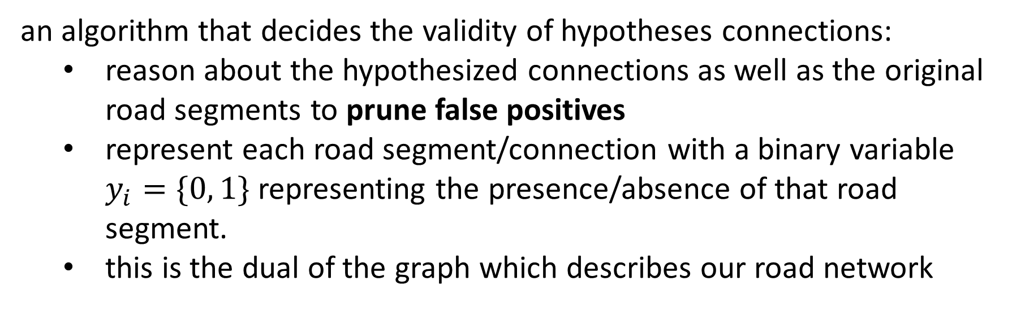
3.4 Reasoning about the connections
an algorithm that decides the validity of hypotheses connections:
reason about the hypothesized connections as well as the original road segments to prune false positives
represent each road segment/connection with a binary variable $y_{i}=\{0, 1\}$ representing the presence/absence of that road segment.
this is the dual of the graph which describes our road network
Notes:
决定假设连接有效性的算法：
关于假设连接以及修剪误报的原始路段的原因
表示每个路段/连接的二进制变量𝑦_𝑖= {0,1}表示该路段的存在/不存在。
这是描述我们道路网络的图表的双重性

Slide 17
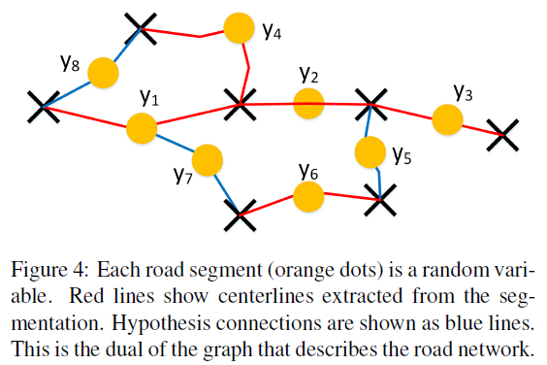
3.4 Reasoning about the connections
an algorithm that decides the validity of hypotheses connections:
reason about the hypothesized connections as well as the original road segments to prune false positives
represent each road segment/connection with a binary variable $y_{i}=\{0, 1\}$ representing the presence/absence of that road segment.
this is the dual of the graph which describes our road network

Slide 18
3.4 Reasoning about the connections
calculate the features by employing different pooling to form additional features:
the soft-max scores along the road segment
the distance to the closest non road pixel
the length of the segment
a binary feature encoding if the node represents a connection hypothesis
the number of connections to other road sections
An Inception network [20] to perform this classification:
The input is a cropped image around the connection with the connection drawn on the image
The output is an additional feature
Notes:
通过使用不同的池来形成其他功能来计算功能：
沿路段的soft-max分数
距离最近的非道路像素的距离
段的长度
如果节点表示连接假设，则编码二进制特征
与其他路段的连接数
一个Inception网络[20]执行此分类：
输入是连接周围的裁剪图像，图像上绘制了连接
输出是一个附加特征

Slide 19
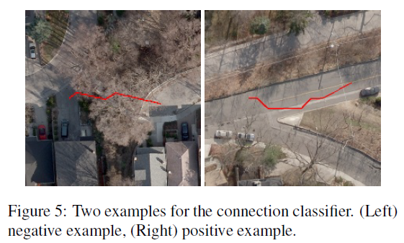
3.4 Reasoning about the connections
calculate the features by employing different pooling to form additional features:
the soft-max scores along the road segment
the distance to the closest non road pixel
the length of the segment
a binary feature encoding if the node represents a connection hypothesis
the number of connections to other road sections
An Inception network [20] to perform this classification:
The input is a cropped image around the connection with the connection drawn on the image
The output is an additional feature
Notes:
通过使用不同的池来形成其他功能来计算功能：
沿路段的soft-max分数
距离最近的非道路像素的距离
段的长度
如果节点表示连接假设，则编码二进制特征
与其他路段的连接数
一个Inception网络[20]执行此分类：
输入是连接周围的裁剪图像，图像上绘制了连接
输出是一个附加特征

Slide 20
4 Learning and Metrics
the ground truth graph and the estimated graph have different topology
the road hypothesis on both graphs have also different shape
How to do learning and evaluate our results?
Notes:
地面实况图和估计图具有不同的拓扑结构
两个图上的道路假设也有不同的形状
如何学习和评估我们的结果？

Slide 21

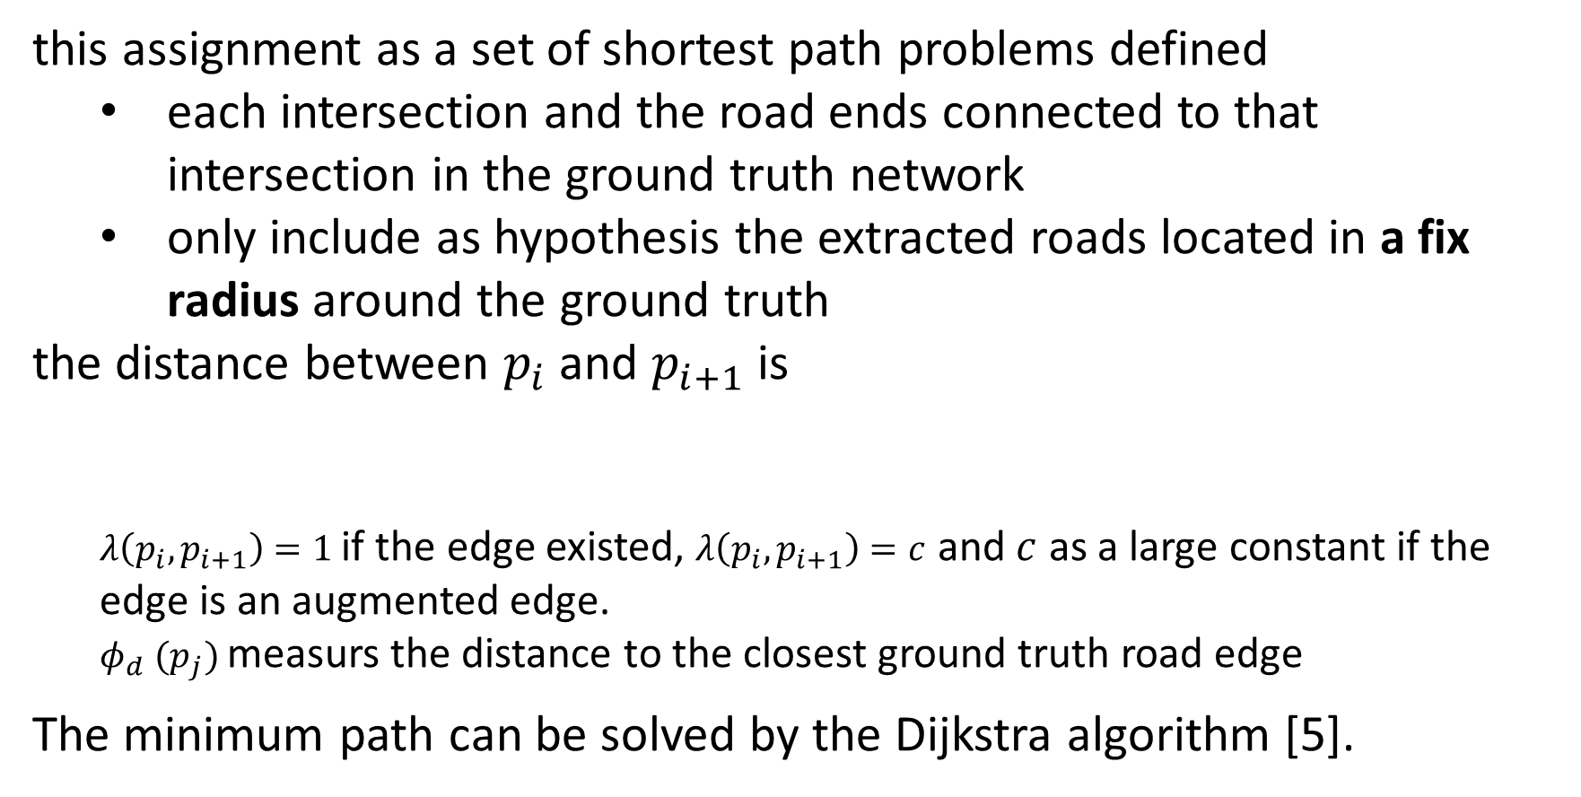
4.1 Assignment of GT roads to extracted roads
this assignment as a set of shortest path problems defined
each intersection and the road ends connected to that intersection in the ground truth network
only include as hypothesis the extracted roads located in a fix radius around the ground truth
the distance between $p_{i}$ and $p_{i+1}$ is
$λ\left(p_{i}, p_{i+1}\right)=1$ if the edge existed, $λ\left(p_{i}, p_{i+1}\right)=c$ and $c$ as a large constant if the edge is an augmented edge.
$φ_{d} (p_{j})$ measurs the distance to the closest ground truth road edge
The minimum path can be solved by the Dijkstra algorithm [5].
Notes:
这个分配定义为一组最短路径问题
每个交叉路口和道路两端连接到地面实况网络中的交叉路口
仅包括位于地面事实周围的固定半径中的提取道路的假设连接
Pi和pi+1之间的最短路径

Slide 22
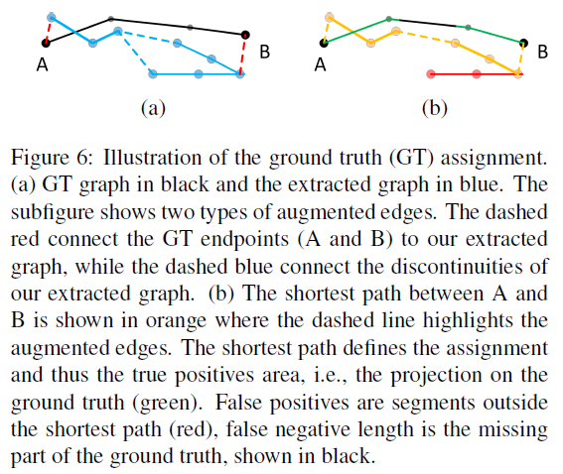
4.1 Assignment of GT roads to extracted roads
this assignment as a set of shortest path problems defined
each intersection and the road ends connected to that intersection in the ground truth network
only include as hypothesis the extracted roads located in a fix radius around the ground truth
the distance between $p_{i}$ and $p_{i+1}$ is
$λ\left(p_{i}, p_{i+1}\right)=1$ if the edge existed, $λ\left(p_{i}, p_{i+1}\right)=c$ and $c$ as a large constant if the edge is an augmented edge.
$φ_{d} (p_{j})$ measurs the distance to the closest ground truth road edge
The minimum path can be solved by the Dijkstra algorithm [5].
Notes:
这个分配定义为一组最短路径问题
每个交叉路口和道路两端连接到地面实况网络中的交叉路口
仅作为假设包括位于地面事实周围的固定半径中的提取道路
Pi和pi+1之间的最短路径

Slide 23
4.2 Learning
all the original edges on the shortest path are considered as true positives
the edges that are not part of any shortest path are considered as false positives
train model using max margin loss
use the Hamming distance as the task loss
Notes:
最短路径上的所有原始边缘都被视为真正的正面
不属于任何最短路径的边缘被视为误报
使用最大边界损失训练模型
使用汉明距离作为任务损失

Slide 24

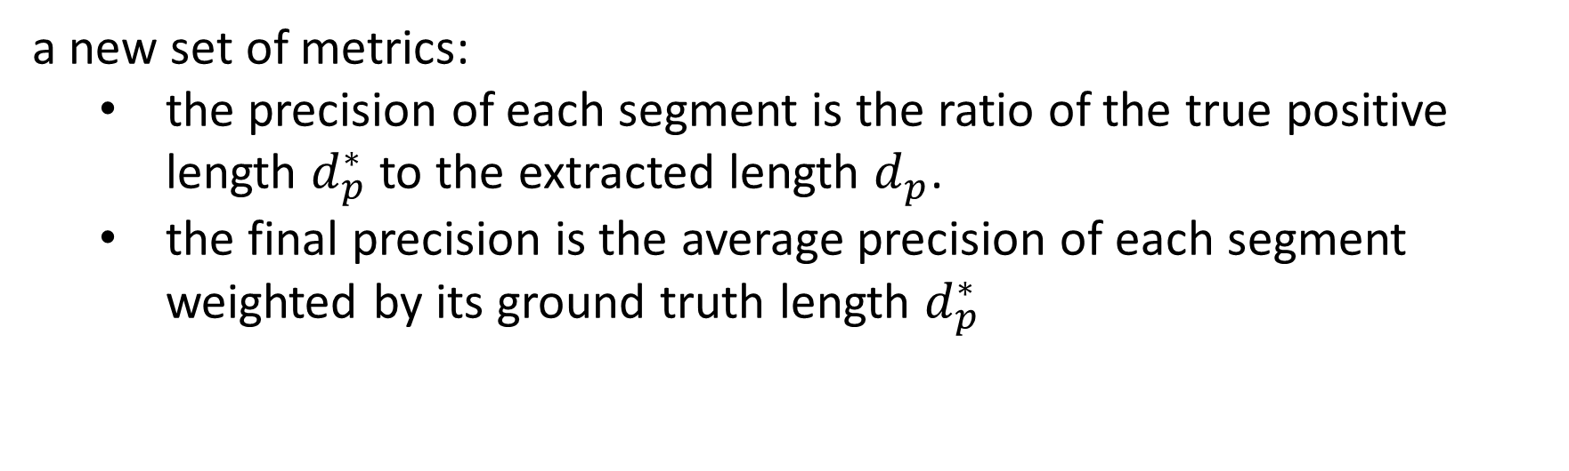
4.3 Evaluating Topology
a new set of metrics:
the precision of each segment is the ratio of the true positive length $d_{p}^{∗}$ to the extracted length $d_{p}$.
the final precision is the average precision of each segment weighted by its ground truth length $d_{p}^{∗}$
Notes:
一组新的指标：
每个段的精度是真正的正长度𝑑_𝑝^ *与提取的长度𝑑_𝑝的比率。
最终精度是每个段的平均精度加权其地面实况长度𝑑_𝑝^ *

Slide 25



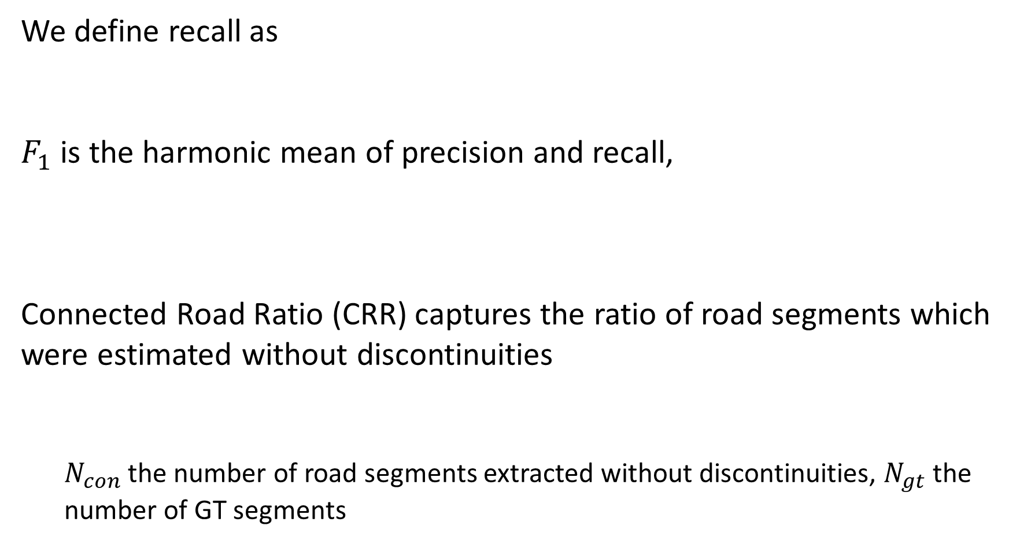
4.3 Evaluating Topology
We define recall as
$F_{1}$ is the harmonic mean of precision and recall,
Connected Road Ratio (CRR) captures the ratio of road segments which were estimated without discontinuities
$N_{con}$ the number of road segments extracted without discontinuities, $N_{gt}$ the number of GT segments
Notes:
我们将召回定义为
𝐹_1是精度和召回的调和平均值，
连通道路比率（CRR）记录了无间断估计的路段比率: 𝑁_𝑐𝑜𝑛在提取处的连续的路段数量，𝑁_𝑔𝑡 真实段的数量

Slide 26
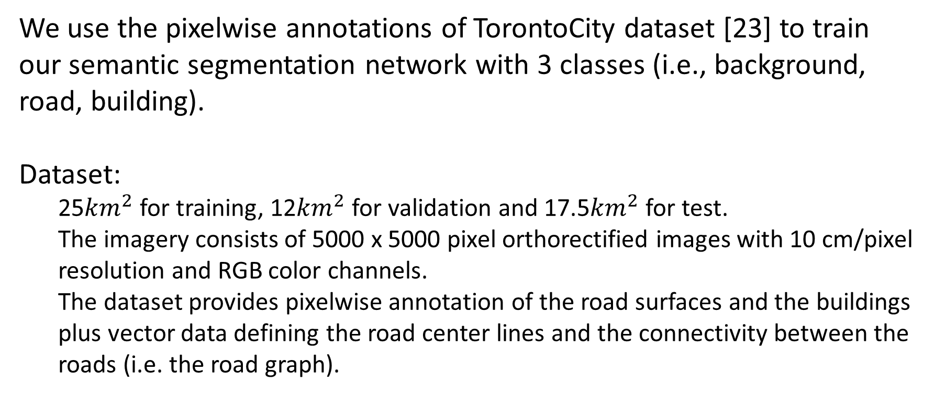
5 Experiments
We use the pixelwise annotations of TorontoCity dataset [23] to train our semantic segmentation network with 3 classes (i.e., background, road, building).
Dataset:
25${km}^{2}$ for training, 12${km}^{2}$ for validation and 17.5${km}^{2}$ for test.
The imagery consists of 5000 x 5000 pixel orthorectified images with 10 cm/pixel resolution and RGB color channels.
The dataset provides pixelwise annotation of the road surfaces and the buildings plus vector data defining the road center lines and the connectivity between the roads (i.e. the road graph).
Notes:
我们使用TorontoCity数据集[23]的逐像素注释来训练我们的语义分割网络有3个类别（即背景，道路，建筑物）。
数据集：
25为训练，12为验证，17.5为试验。
该图像由5000 x 5000像素的正射校正图像组成，具有10 cm /像素分辨率和RGB颜色通道。
数据集提供道路表面和建筑物的像素化注释以及定义道路中心线和道路之间的连通性（即道路图）的矢量数据。

Slide 27
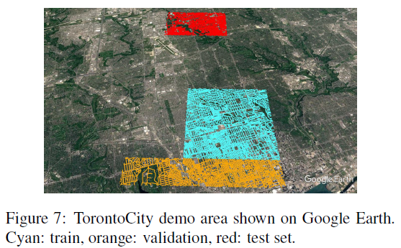
5 Experiments
We use the pixelwise annotations of TorontoCity dataset [23] to train our semantic segmentation network with 3 classes (i.e., background, road, building).
Dataset:
25${km}^{2}$ for training, 12${km}^{2}$ for validation and 17.5${km}^{2}$ for test.
The imagery consists of 5000 x 5000 pixel orthorectified images with 10 cm/pixel resolution and RGB color channels.
The dataset provides pixelwise annotation of the road surfaces and the buildings plus vector data defining the road center lines and the connectivity between the roads (i.e. the road graph).
Notes:
我们使用TorontoCity数据集[23]的逐像素注释来训练我们的语义分割网络有3个类别（即背景，道路，建筑物）。
数据集：
25为训练，12为验证，17.5为试验。
该图像由5000 x 5000像素的正射校正图像组成，具有10 cm /像素分辨率和RGB颜色通道。
数据集提供道路表面和建筑物的像素化注释以及定义道路中心线和道路之间的连通性（即道路图）的矢量数据。

Slide 28
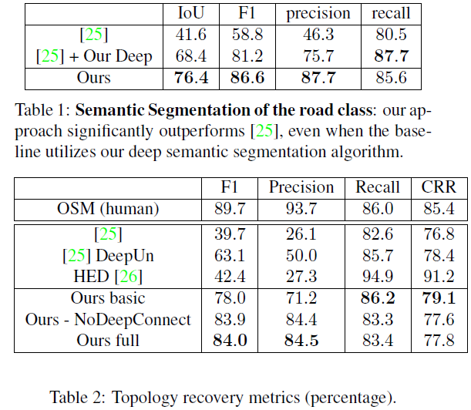
5 Experiments
Baselines:
we compare to the freely available OpenStreetMap project [1] road maps as baseline.
We compare our method to the work of Wenger et al. [24, 25]
We compare also to HED [26] which predicts the road centerlines directly by a deep net.
Notes:
基线：
我们将免费提供的OpenStreetMap项目[1]路线图作为基线进行比较。
我们将我们的方法与Wenger等人的工作进行了比较。 [24,25]
我们还比较HED [26]，它直接用深网预测道路中心线。

Slide 29
5 Experiments
Learning details:
The inputs is 1440 x 1440 resolution patches randomly cropped from the raw images
The network is trained with Adam [12] for 80 rounds
We use batch size of 3 perform 300 iterations for each round.
The weights are initialized using MSR initialization [9]
To train the Inception network:
a training set of 22000 images
1/3 creating connection hypotheses on the training set
1/3 generating additional examples from the road graph
1/3 adding negative examples
For training we use a learning rate of 0.001, a momentum of 0.9 and train the network for 100 epochs.
Notes:
学习细节：
输入是1440 x 1440分辨率补丁，随机翻转从原始图像中随机裁剪
该网络由Adam [12]训练80轮
我们使用批量大小为3的每轮执行300次迭代。
使用MSR初始化[9]初始化权重
训练Inception网络：
一套22000张图像的训练集
1/3在训练集上创建连接假设
1/3从路线图中生成其他示例
1/3添加负面例子
对于训练，我们使用0.001的学习率，0.9的动量并训练网络100个时期。

Slide 30
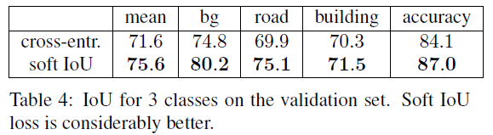

5 Experiments
Metrics:
intersection over union (IoU)
precision
recall
$F_{1}$
the accuracy of the shape and topology of the road network.
Soft IoU vs. cross-entropy loss:
Notes:
指标：
联合交叉（IoU）
精确
召回
𝐹_1
道路网络的形状和拓扑的准确性。
IoU与交叉熵损失：

Slide 31
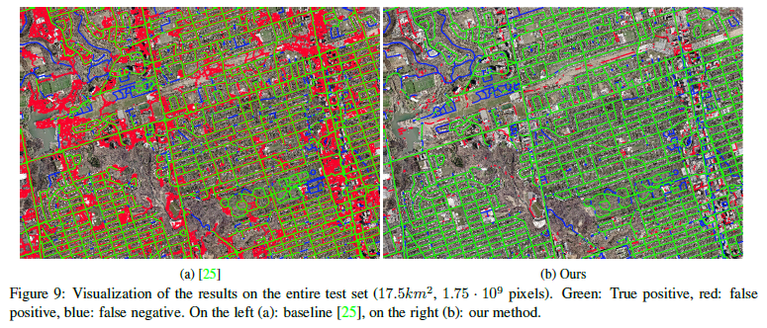
5 Experiments
Comparison to the state-of-the-art:

Slide 32
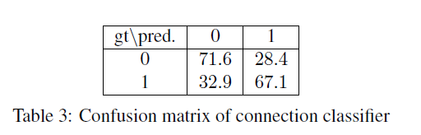
5 Experiments
Ablation studies:
Our basic algorithm only extracts the road center line from our semantic segmentation without reasoning about connectivity.
Our second version reasons about connectivity but does not utilize the Inception classifier.
The last version is our full model.
Adding the deep unary connection classifier improves the performance only slightly.
Notes:
我们的基本算法仅从我们的语义分段中提取道路中心线，而无需考虑连通性。
我们的第二个版本有关连接的原因，但没有使用Inception分类器。
最后一个版本是我们的完整型号。
添加深度一元连接分类器只会略微提高性能。

Slide 33
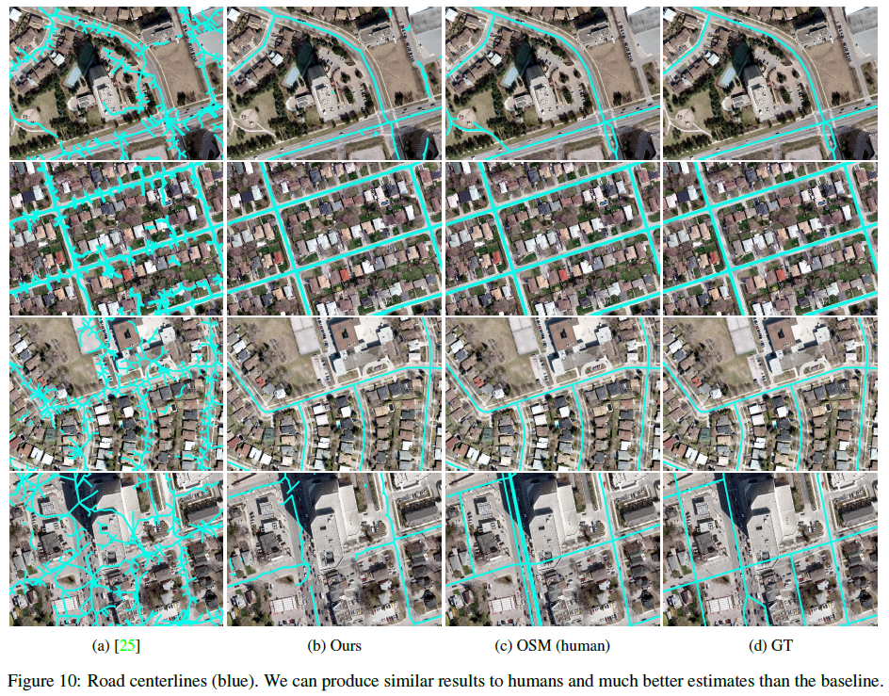
5 Experiments
Qualitative Results:

Slide 34
6 Conclusion
In this paper we have presented an approach that directly
estimates road topology from aerial images.
We have taken advantage of the latest developments in deep learning to have an initial segmentation of the aerial images.
We have then derived an algorithm that reasons about missing connections in the extracted road topology as a shortest path problem.
We have demonstrated our approach in the TorontoCity dataset [23] and show improvements over the state-of-the-art [25].
In the future we plan to extract additional information such as building footprints in order to enrich our maps.
Notes:
在本文中，我们直接提出了一种方法
估计航拍图像的道路拓扑。
我们利用深度学习的最新发展来对航拍图像进行初始分割。
然后，我们推导出一种算法，该算法将提取的道路拓扑中的连接缺失作为最短路径问题。
我们在TorontoCity数据集[23]中展示了我们的方法，并展示了对最新技术的改进[25]。
在未来，我们计划提取其他信息，例如建造足迹，以丰富我们的地图。

